Slide 1
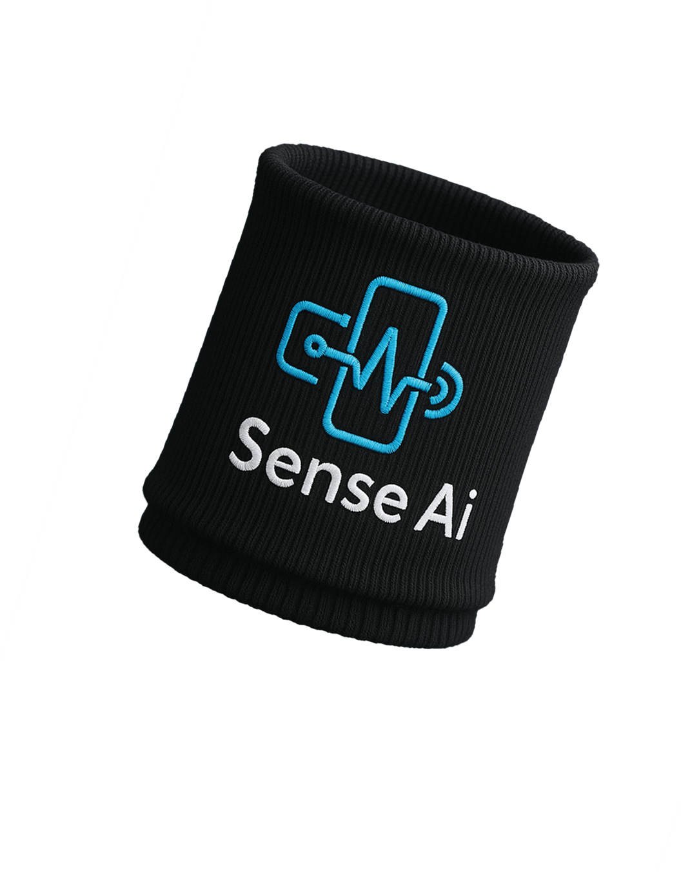
Sense AI – SenseFit: Your Health, At a Glance
Affordable wearable wristband for continuous health monitoring.
Ideal for fitness enthusiasts, busy urbanites, and elderly care.

Slide 2
Group Members:
Muhammad Hassaan Raza
Kanza Kashaf
Muhammad Faaiza Imtiaz
22-NTU-CS-1362
22-NTU-CS-1350
22-NTU-CS-1360

Slide 3
Problem Statement
High Cost
Fragmented Monitoring
Elderly Care Challenges
Popular devices cost thousands of rupees; SenseFit priced at PKR 3,000.
Multiple gadgets needed for vitals; no unified low-cost device.
6% of Pakistanis are over 60; 60% have chronic conditions.
Hard to get a complete health picture.
Caregivers need real-time, low-cost remote monitoring.
Low- and middle-income users lack affordable options.

Slide 4
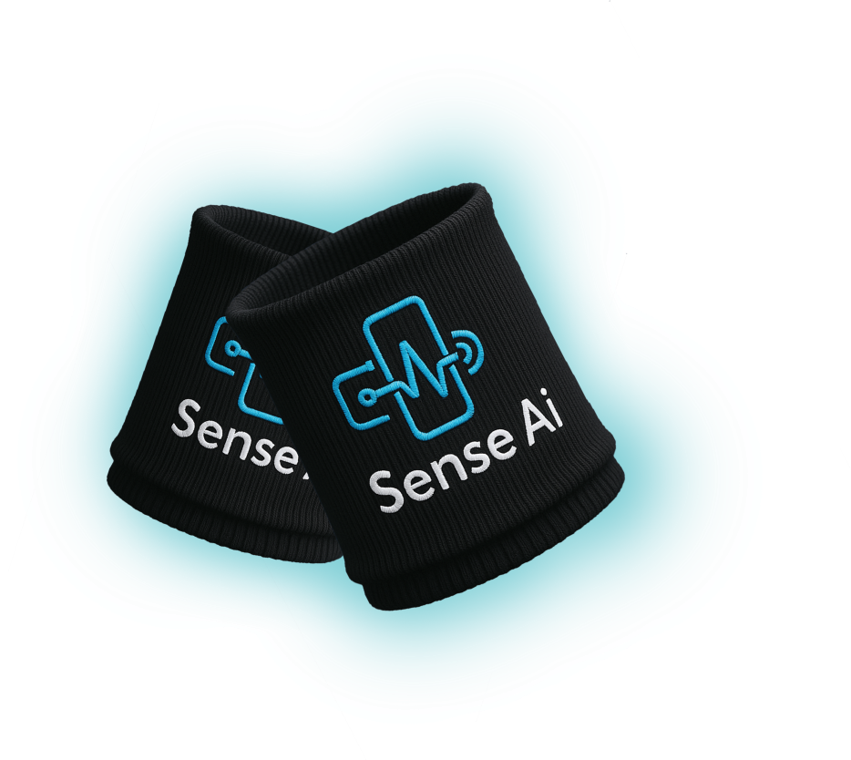
SenseFit Solution
All-in-One Wearable
Integrates temperature, SpO₂, heart rate, and Accelerometer sensors.
Live Dashboard
Bluetooth sync to web and mobile apps for real-time data.
Smart Health Modes
Early Warning, Activity Motivation, and Family Sharing features.

Slide 5
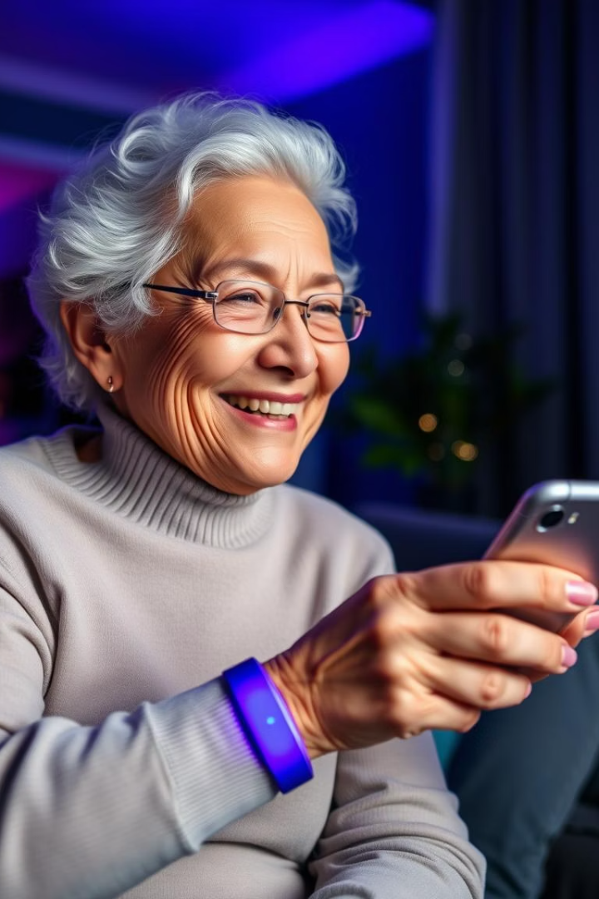
Designed for Older Adults
Health Monitoring
Alert System
Supports independence with continuous vital tracking at home.
Detects fever, hypoxia, irregular heartbeats, and inactivity.
Caregiver Access
Family members receive alerts and weekly health summaries.

Slide 6
Product Overview & Hardware
Prototype Status
Planned Refinements
Working fabric wristband with integrated sensors and ESP32-C3.
Splashproof casing, detachable module, improved strap design.
Not yet waterproof; worn loosely.
Firmware updates and secure data transmission enabled.

Slide 7
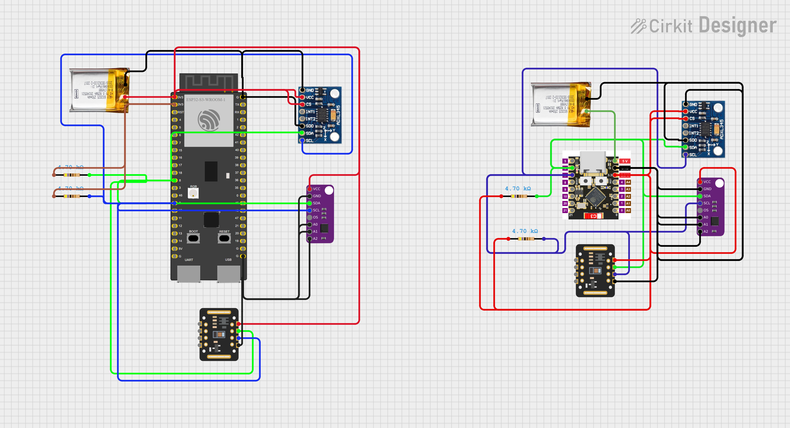
Circuit Diagram

Slide 8
Hardware Components
List of components
Component | Model | Purpose | Library Used
MCU | ESP32-C3 | Wi-Fi/BLE, GPIO, edge ML | WiFi.h, HTTPClient.h
Temperature Sensor | MAX30205 | High precision skin temperature | ClosedCube_MAX30205
Heart Rate & SpO₂ | MAX30102 | Red/IR LED-based pulse and oxygen data | SparkFun MAX3010x
Accelerometer | ADXL345 | X, Y axis motion + free-fall detection | Adafruit_ADXL345_U
Optional Sensor | DHT11/DHT22 | Environmental sensing (training only) | Adafruit_DHT

Slide 9
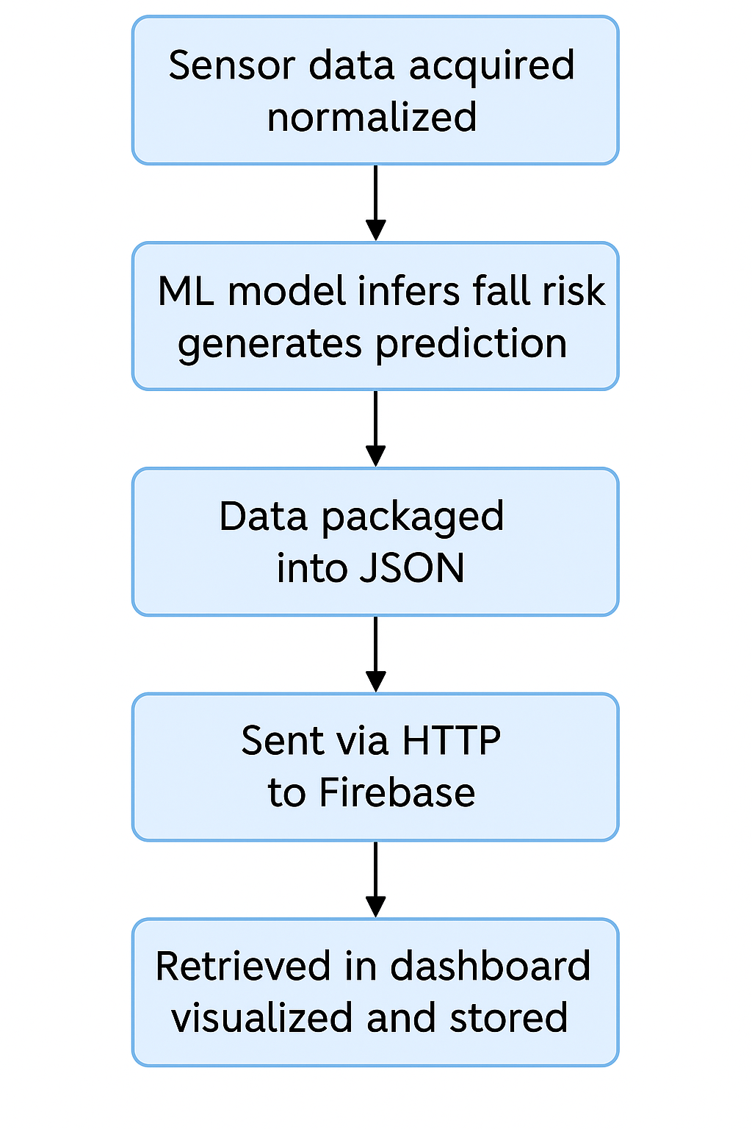
Flow Diagram

Slide 10




Business Model
Device Sales
One-time purchase at PKR 3,000; bulk pricing for hospitals.
Freemium Subscription
Basic dashboard free; PKR 200/month for premium analytics.
B2B Partnerships
Licensing to healthcare providers, gyms, and telehealth firms.

Slide 11






Market Opportunity
Global
$91.2B wearable medical market in 2024; 18% growth projected.
Pakistan
87M internet users, $5.2B e-commerce in 2023; rising health awareness.
Trends
Chronic disease rise, preventive health, telemedicine growth.

Slide 12
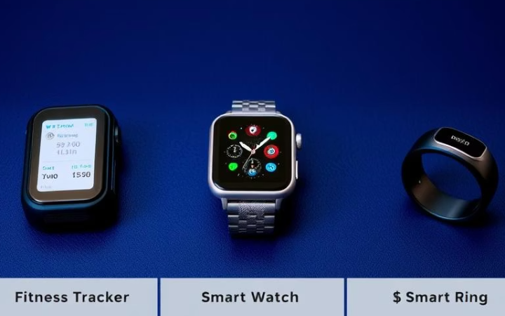
Competitive Landscape
Global Brands
Local Solutions
Apple, Samsung, Fitbit costly; lack low-price all-in-one sensors.
Generic smart bands clone fitness features; no caregiver focus.
SenseFit Differentiators
Affordable, caregiver-centric, web dashboard, localized insights.

Slide 13
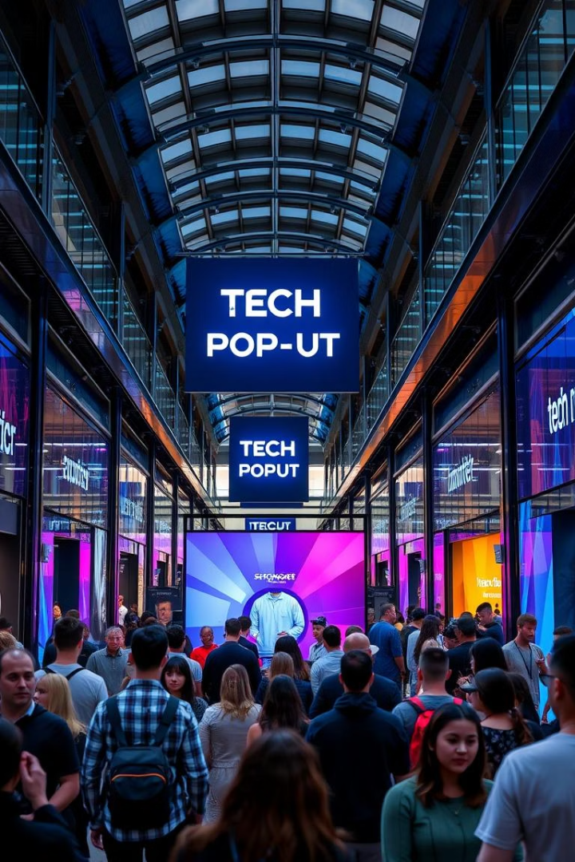
Go-To-Market Strategy
Launch Timeline
Full launch in Q1 2026 after prototype refinement and beta testing.
Manufacturing
Components made in China; assembly and QC in Pakistan.
Sales Channels
E-commerce, pop-up events, hospitals, and medical distributors.
Marketing
Target youth, families, caregivers via social media and NGOs.

Slide 14
Financial Projections & Ask
Sales & Revenue
Funding Needs
Year 1: 5,000 units; Year 3: 30,000 units; revenue grows to PKR 90M+.
Seeking R&D investment, product design support, and pilot partnerships.
Subscription adds steady recurring income.
Focus on clinical validation and early production.

